Slide 1
GUNSMOKE MINES
Development Log
Bruno Mirone FGCT4017 Fundamentals of Games Design BA (Hons) Game Design, Level 4, UCA
Built in Unreal Engine 5.6 using Blueprints only

Slide 2
The game
A wild west dungeon crawler seen from above. Shoot bandits, collect keys, open chests, reach checkpoints and kill the boss.
17
4
0
1
assets
days to build
lines of code
continuous level
Player
Combat
WASD movement, aims at the mouse, and dashes with brief invulnerability.
One hitscan weapon, and a shared health component that handles all damage.
Enemies
Loop
Bandits chase and attack. The boss is the same logic with heavier numbers.
Keys open chests, chests give powerups, and checkpoints save your place.

Slide 3
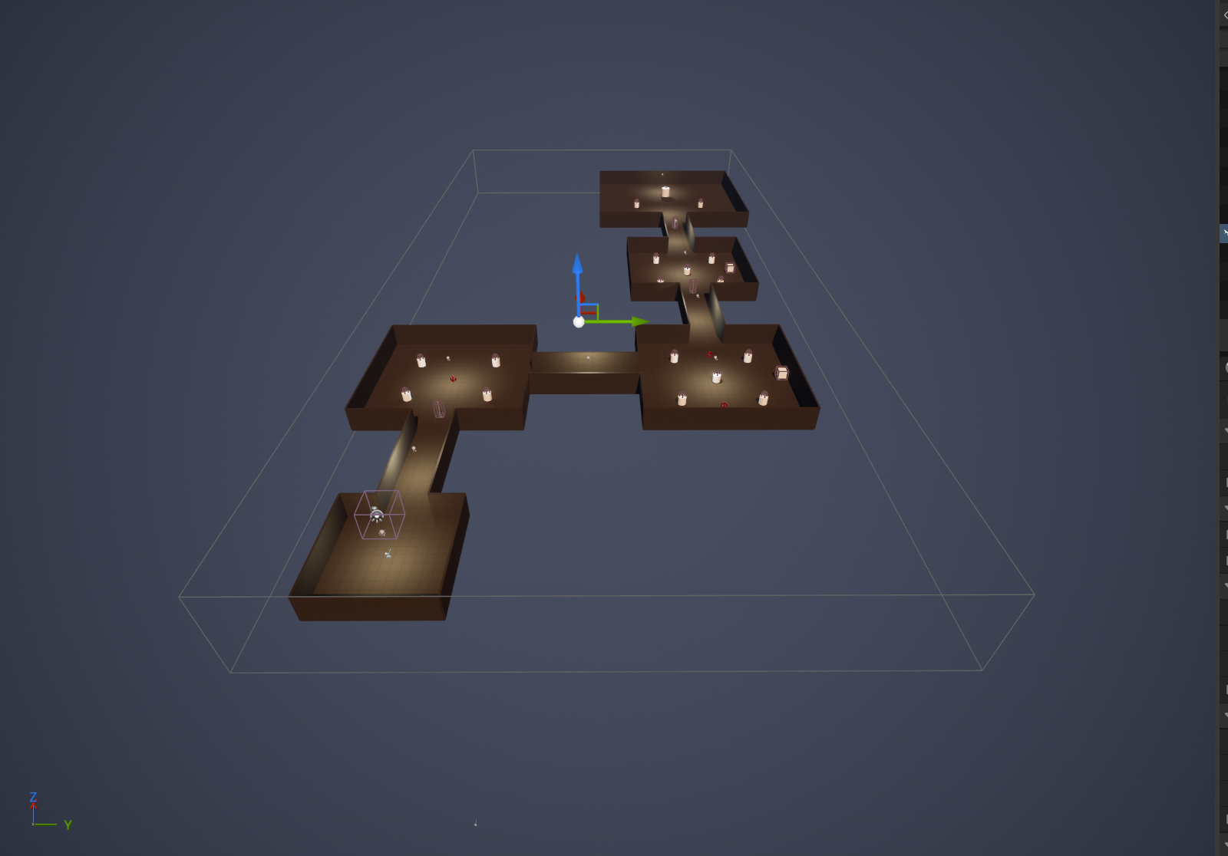
The level
The mine is one continuous level of connected rooms and corridors, blocked out from cubes.
L_Mine, seen from above

Slide 4
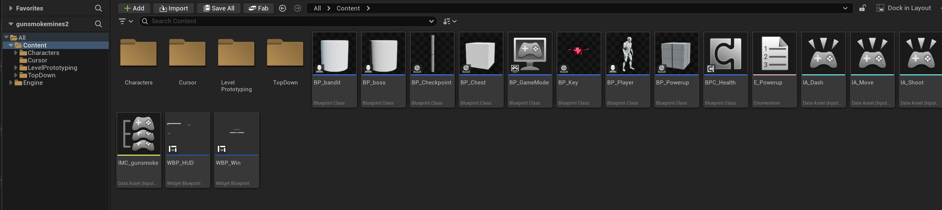
Everything in the project
Seventeen assets in total: eight Blueprints, a shared component, two widgets, the input set and one level.
Content Browser

Slide 5
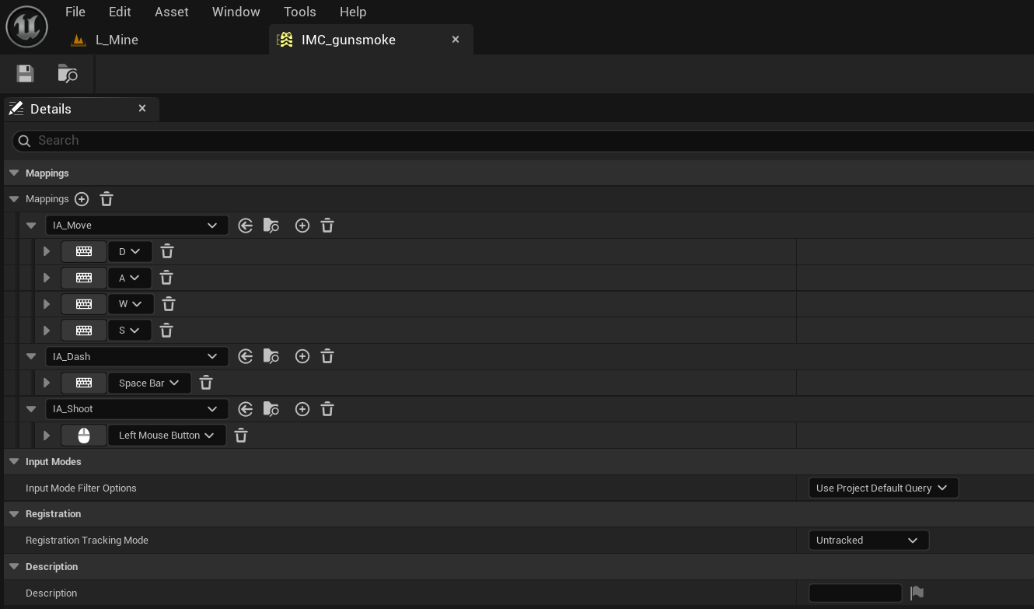
Input
Enhanced Input maps WASD, Space and the left mouse button through a single mapping context.
IMC_gunsmoke

Slide 6
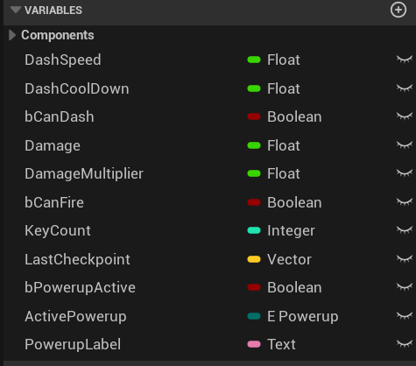
Player variables
Every tunable value lives on the player as a variable, so balancing means editing numbers rather than rewiring.
BP_Player, variables

Slide 7
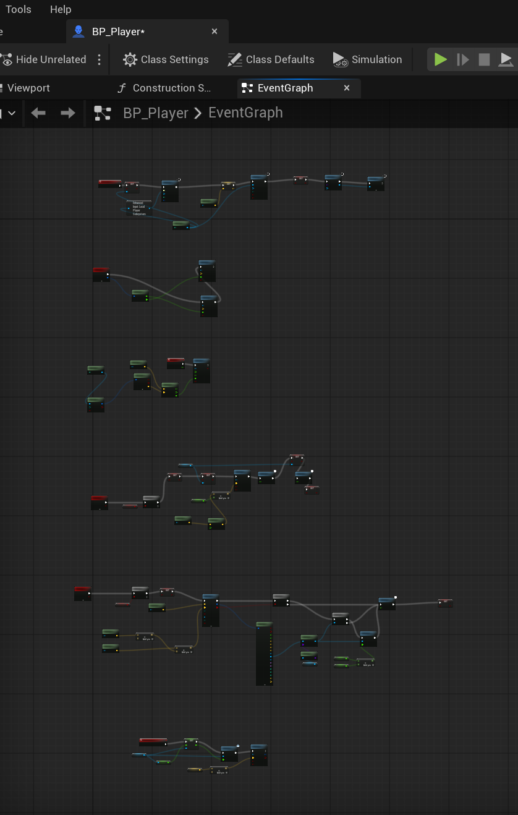
The player
One graph handles movement, mouse aim, the dash, shooting and respawning at the last checkpoint.
BP_Player, Event Graph

Slide 8
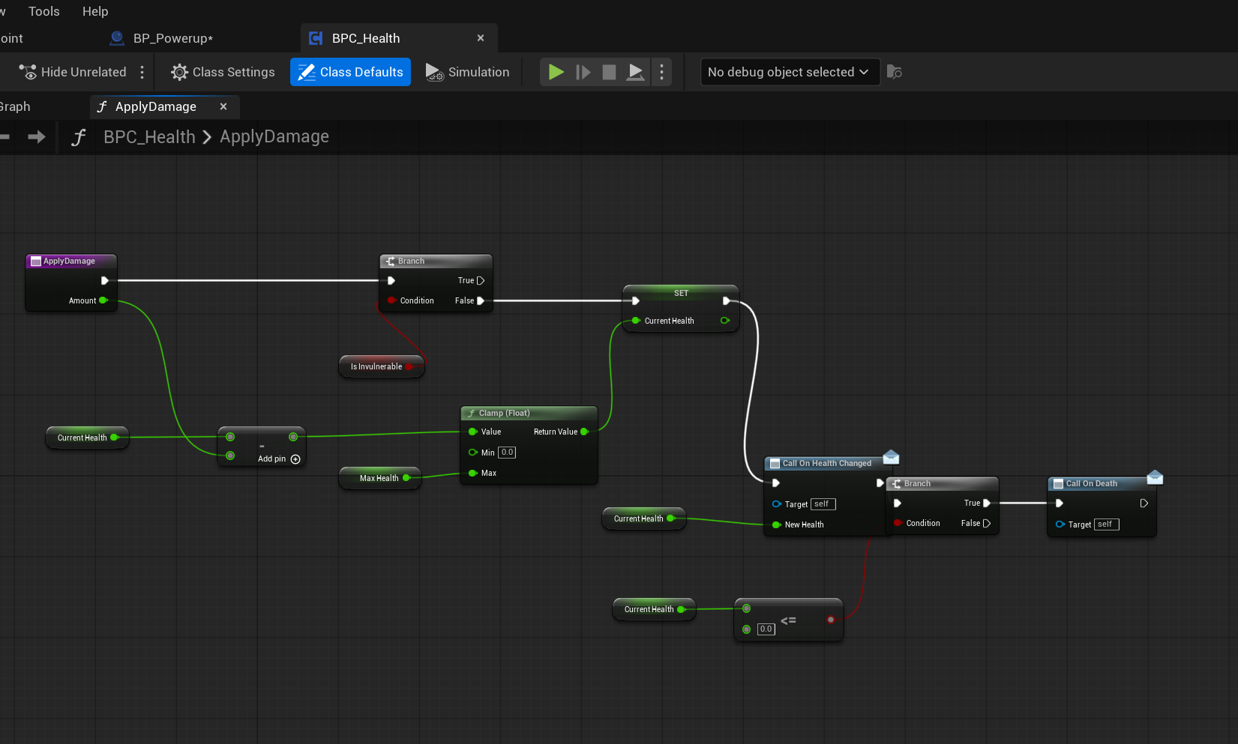
Shared health
A single reusable component handles damage, death and health changes for the player, the bandits and the boss.
BPC_Health, ApplyDamage

Slide 9
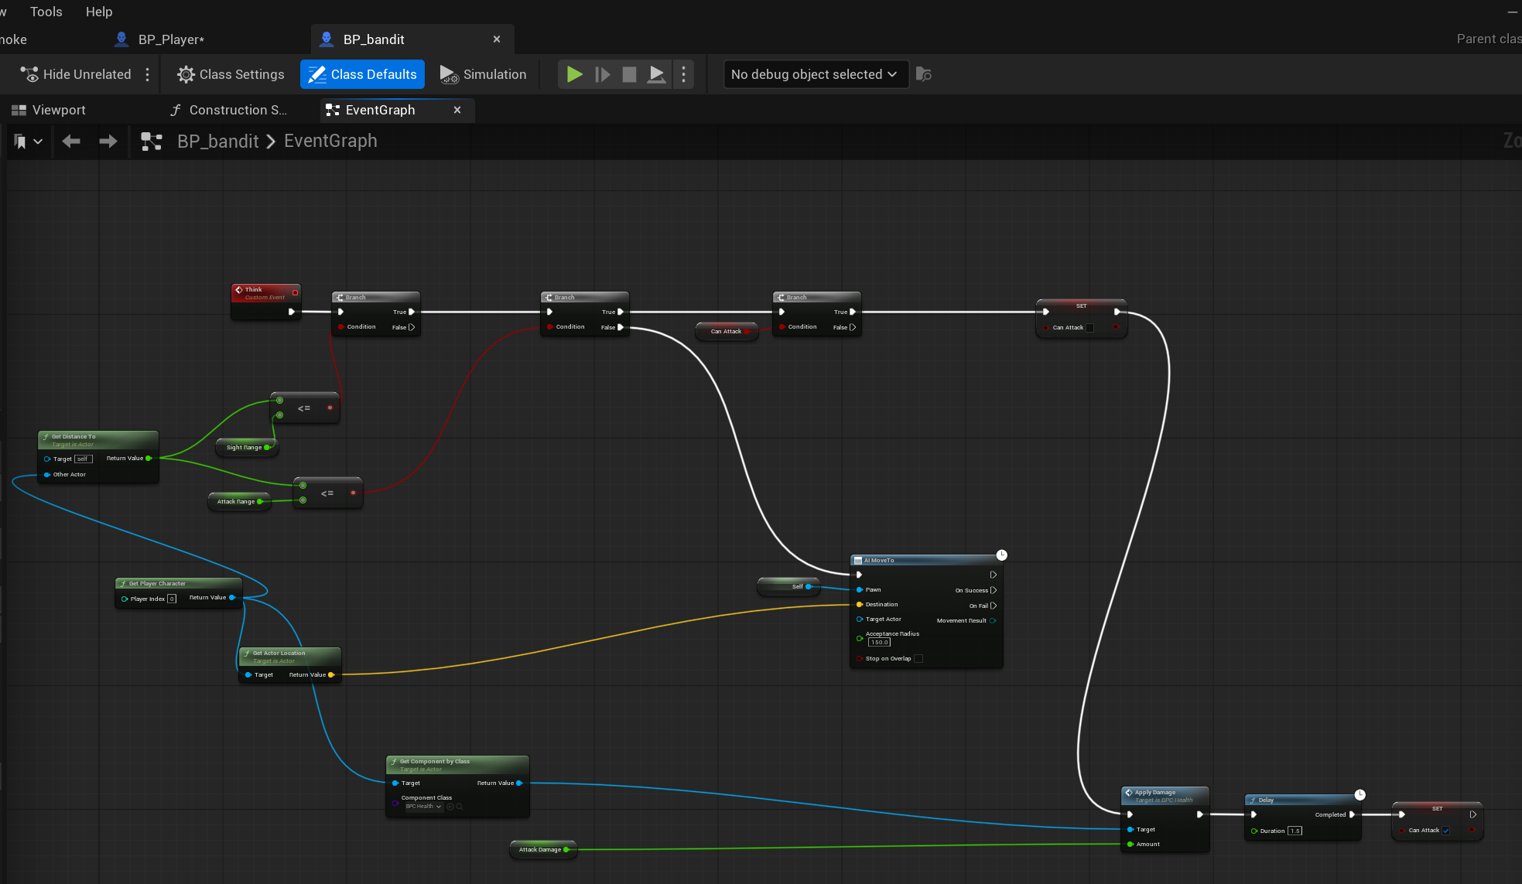
Bandit AI
The bandit measures its distance to the player four times a second and either closes in or attacks.
BP_bandit, Event Graph

Slide 10
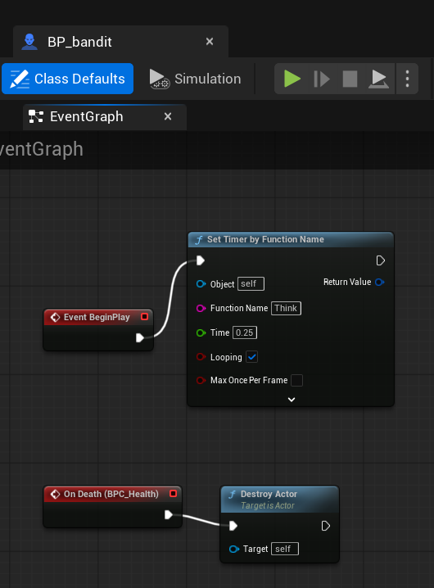
Bandit lifecycle
A looping timer drives the AI, and the health component's death event destroys the actor.
BP_bandit, BeginPlay and death

Slide 11
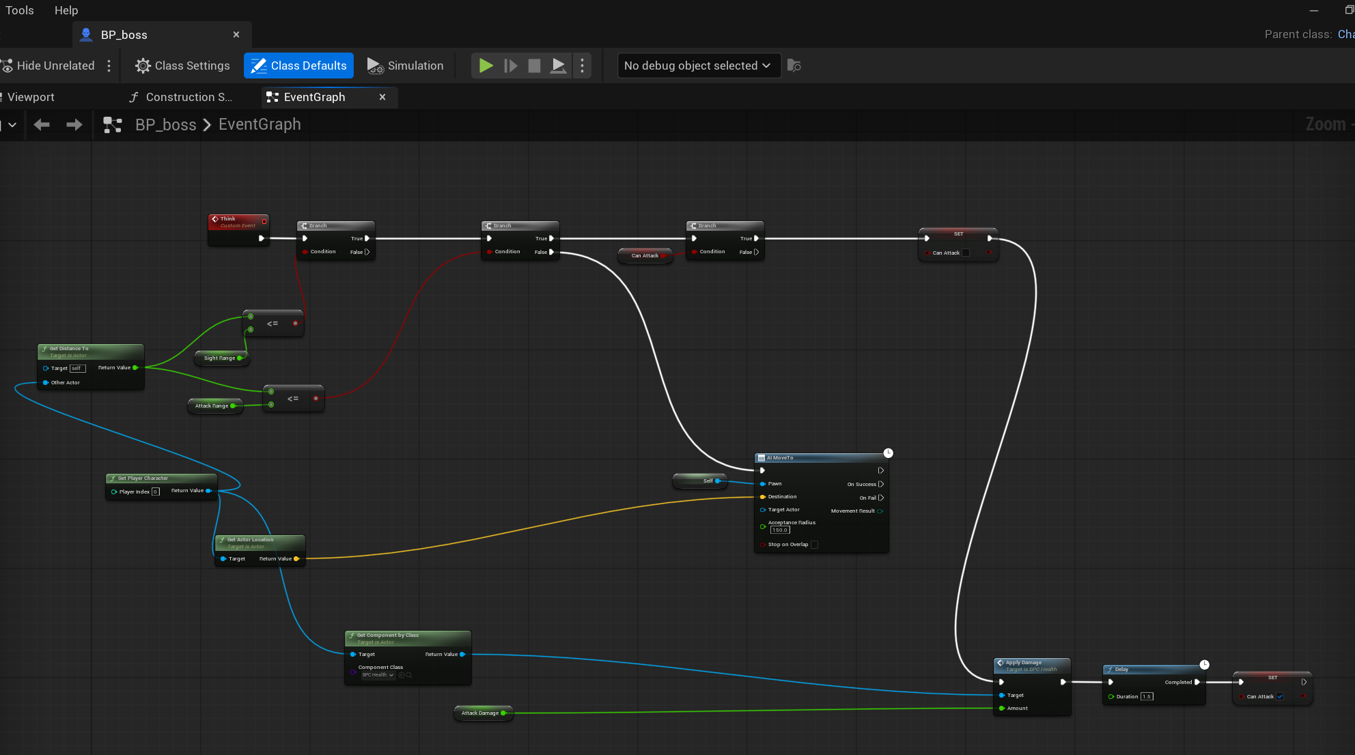
The boss
The boss reuses the bandit's logic with a much larger health pool, slower movement and heavier hits.
BP_boss, Event Graph

Slide 12
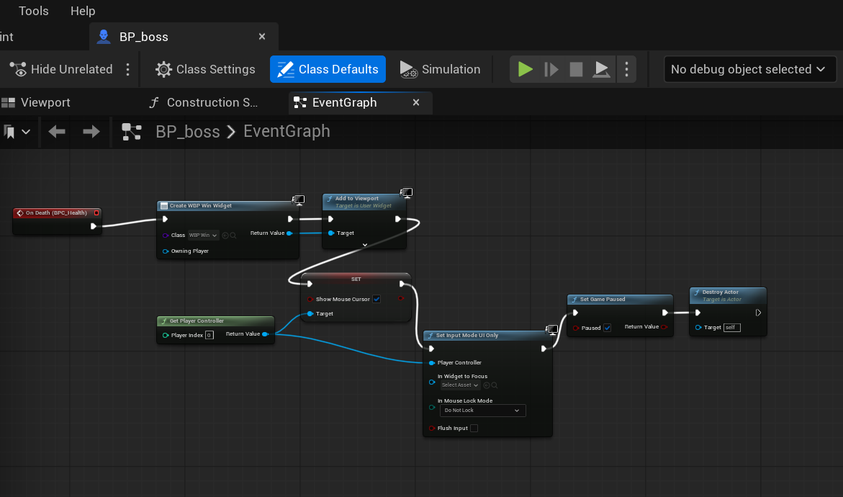
Winning
Killing the boss creates the win widget, pauses the game and hands control back to the mouse.
BP_boss, win condition

Slide 13
Two kinds of powerup
An enumeration keeps the two powerup types readable in the graph instead of using numbers.
E_Powerup

Slide 14
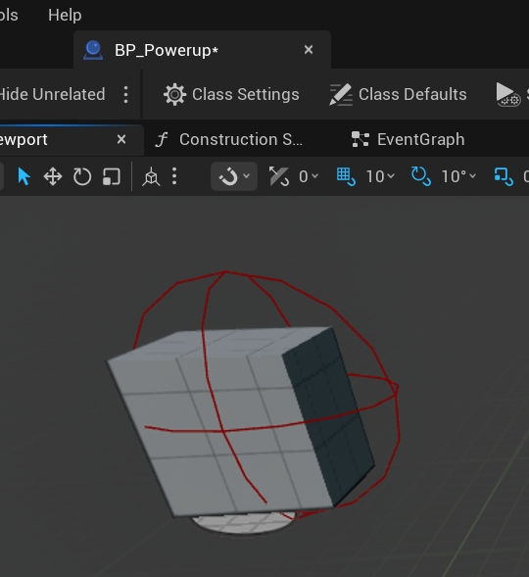
One Blueprint, both powerups
A single actor covers both types, chosen per copy placed in the level.
BP_Powerup, viewport

Slide 15
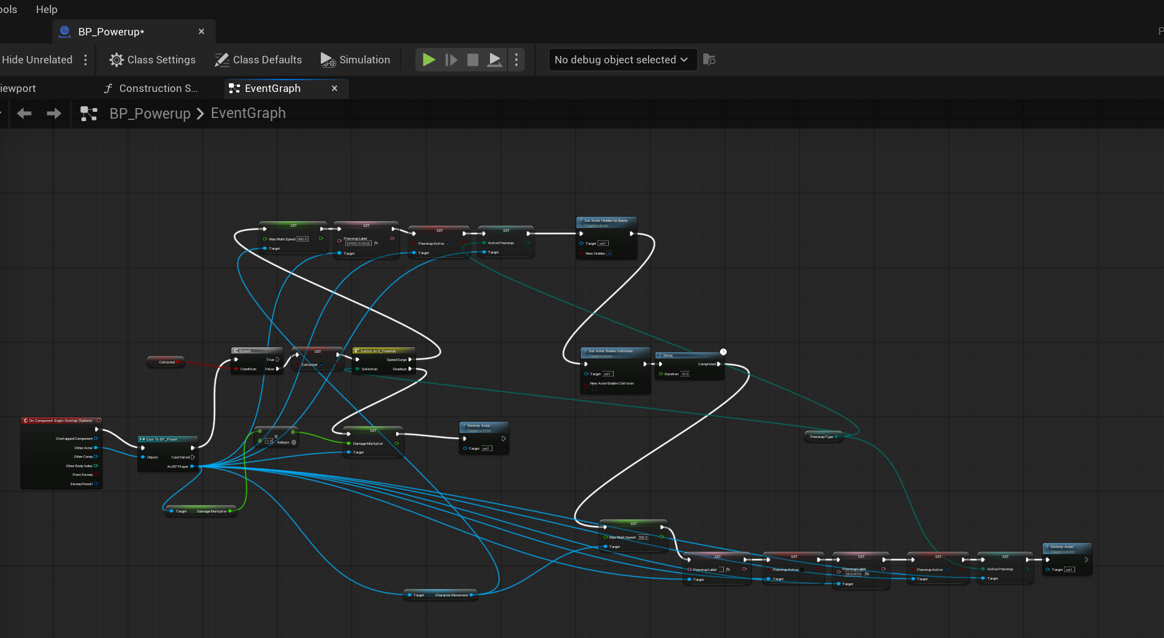
Powerup logic
A switch splits into a timed speed boost that reverts itself, and a permanent damage increase.
BP_Powerup, Event Graph

Slide 16
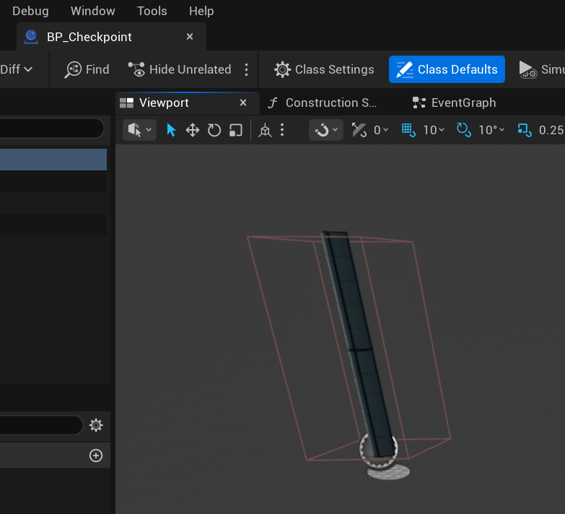
Checkpoints
The checkpoint is a post with a box collision deliberately larger than its mesh, so it is hard to miss.
BP_Checkpoint, viewport

Slide 17
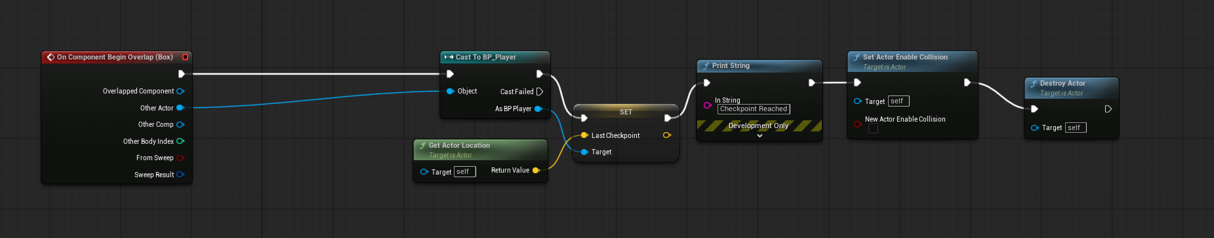
Saving your place
Touching it stores the location on the player and switches off its own collision so it only fires once.
BP_Checkpoint, Event Graph

Slide 18
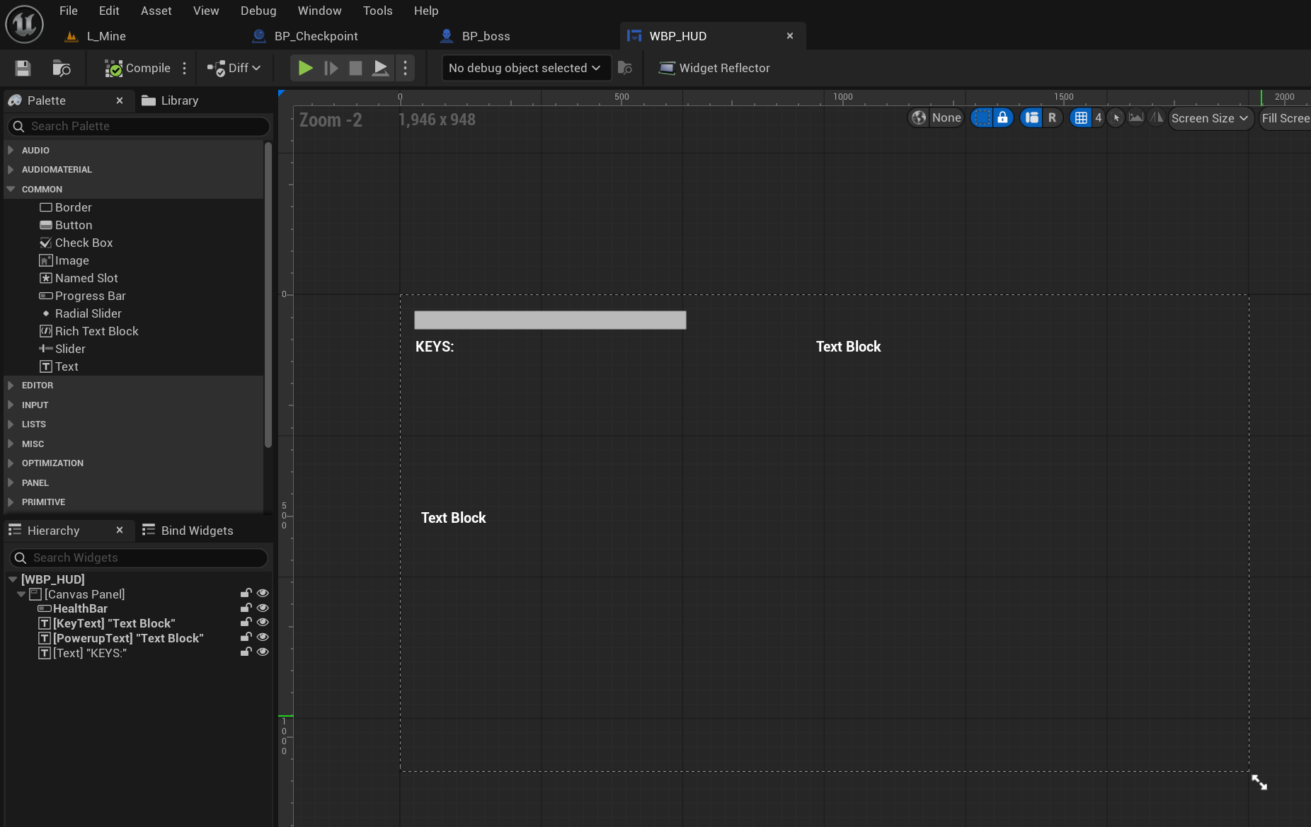
The HUD
The interface is deliberately minimal: a health bar, a key counter and a powerup label.
WBP_HUD, designer

Slide 19
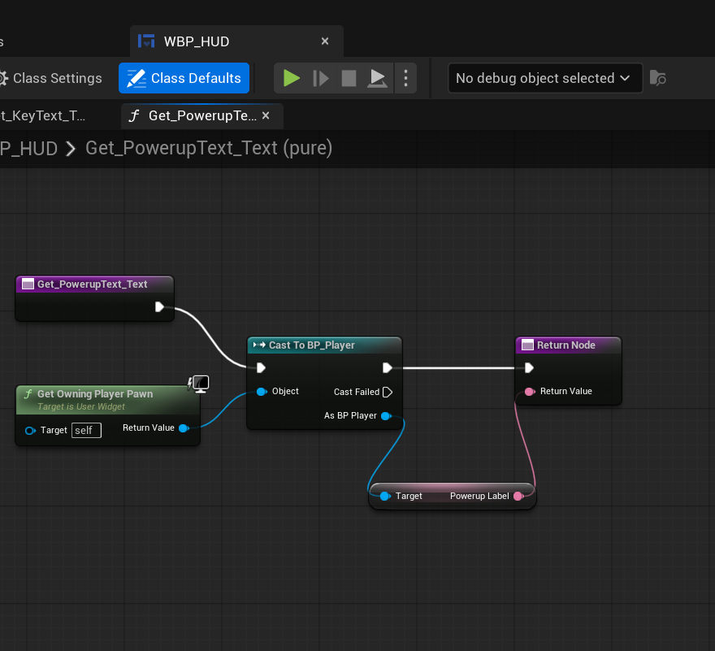
Reading the player
Each HUD element pulls its value from the player through a bound function that runs every frame.
WBP_HUD, text binding

Slide 20
What I learned
Scope first
Reuse beats repetition
The design document describes seven weapons and eight powerups. I built one weapon and two powerups, and recorded every cut and the reason for it.
Writing the health system once as a component meant the player, the bandits and the boss all shared it, and the boss took minutes rather than hours.
Unreal fails quietly
Debugging is a method
Most bugs produced no error at all. A pawn ignoring the visibility channel, a node defaulting its target to itself, a mesh whose collision was larger than the mesh.
Print strings to split a problem in half, collision view to see the invisible, and checking one thing at a time. That mattered more than knowing the engine.

